Slide 1
Predicting Yelp Review Score with Ensemble Learning of MLR and Random Forest
Group 5
Huan Xu, Jin Lee, Grant Zhou

Slide 2

The Data Set
Over 50 predictors including, Id, star, name, city, postal code, text, nChar, nWord, gem, Incredible, and more.
A prediction model to predict the ratings of reviews based on the text.

Slide 3
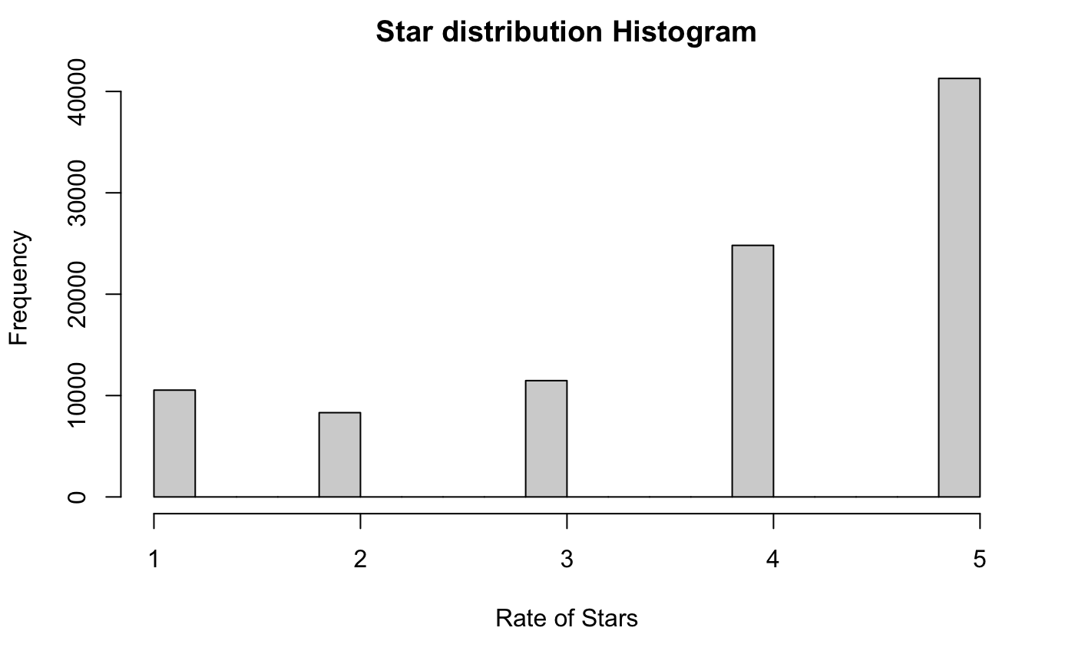

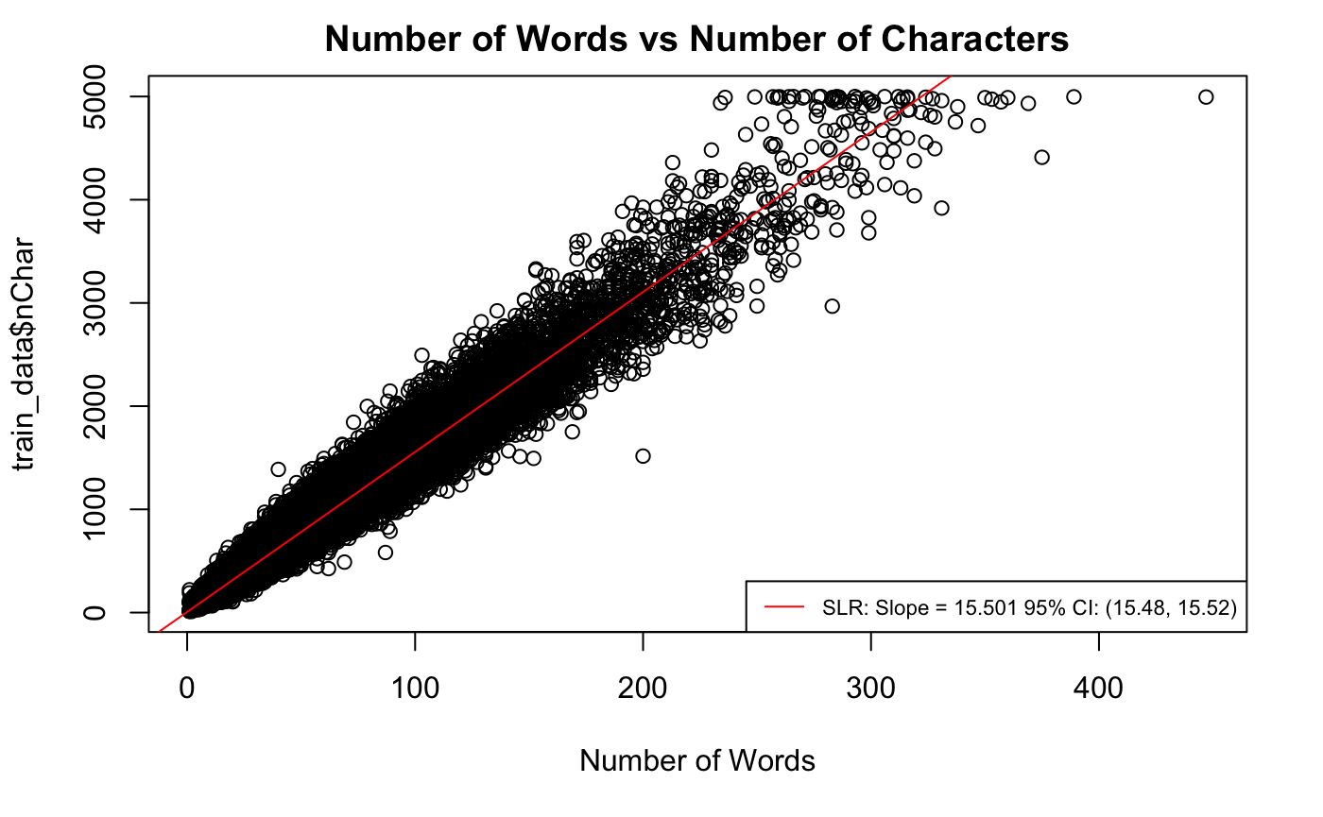
Before Cleaning The Data...
5 Star outcome is greater than any other stars.
Number of Words is proportional to the Number of Characters.
The boxplot of the number of words and stars depicts a small trend as well as boxplot of characters and stars (next page)

Slide 4
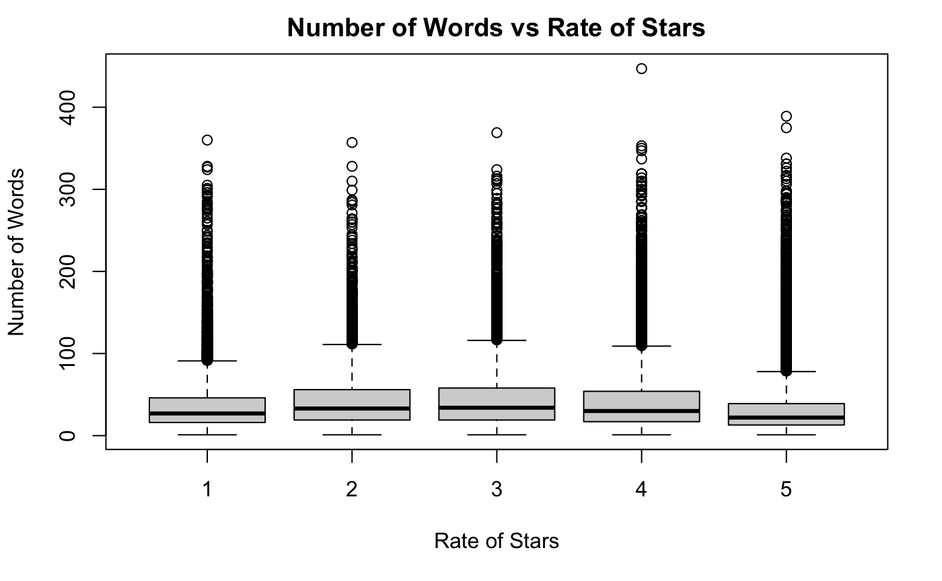
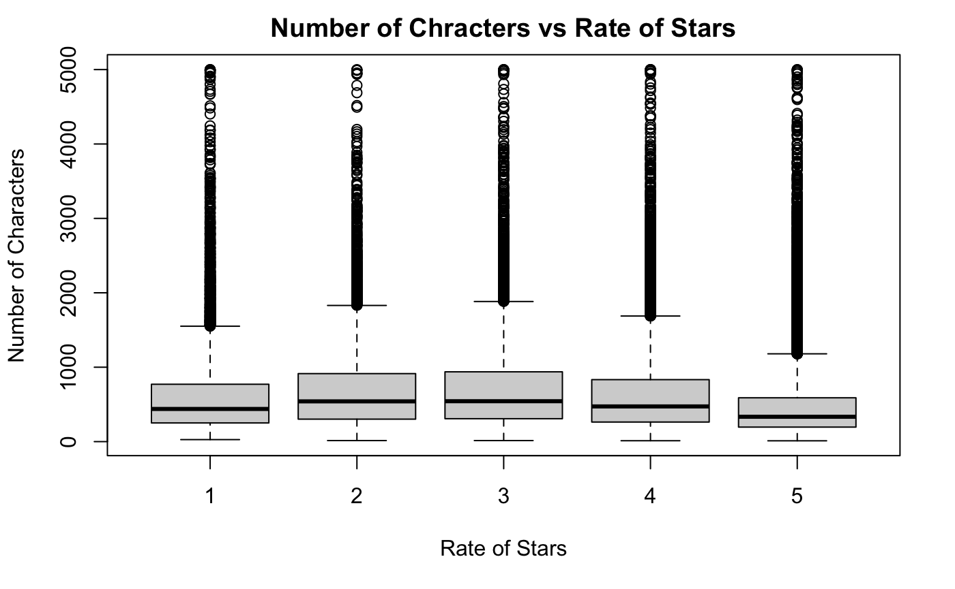

Slide 5
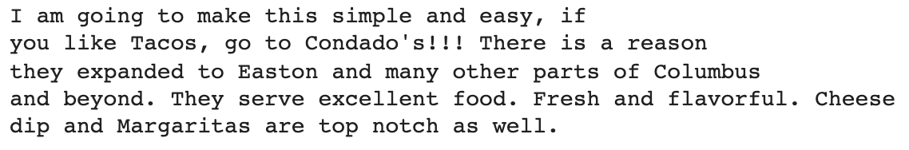
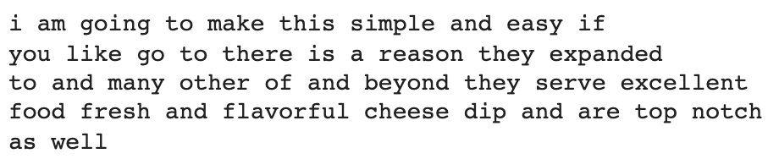
Defining vocabulary
“Hello World, mi friends!”
Remove punctuation
“Hello World mi friends”
Lower case
“hello world mi friends”
Figure 1: before text processing
Only English word
“hello world friends”
Lemmatization
“hello world friend”
Figure 2: after text processing

Slide 6
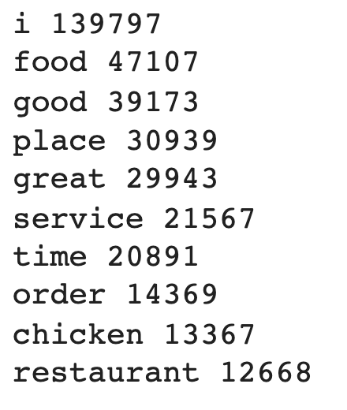
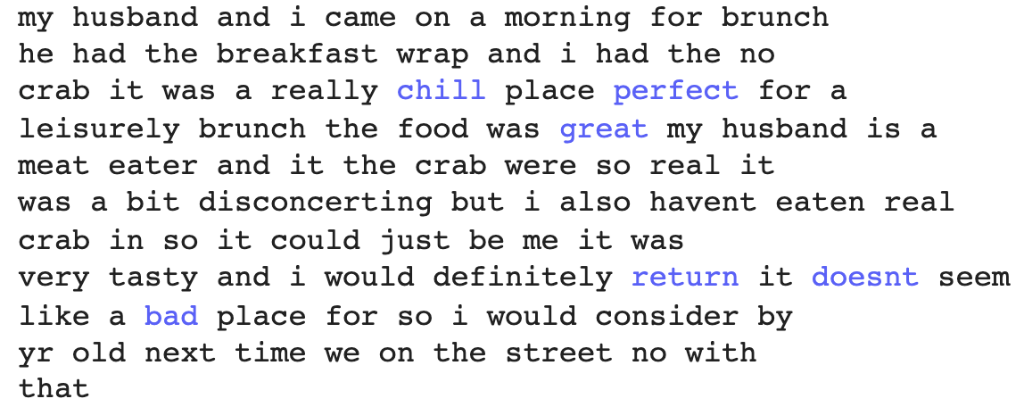
Defining vocabulary
- Leave only Nouns and Adjectives
- Sort in global occurrence and leave Top 1000
- Next step: understand vocabulary
Figure 1: Comment text, blue if word in vocabulary
Figure 2: Top 10 most occurred words

Slide 7
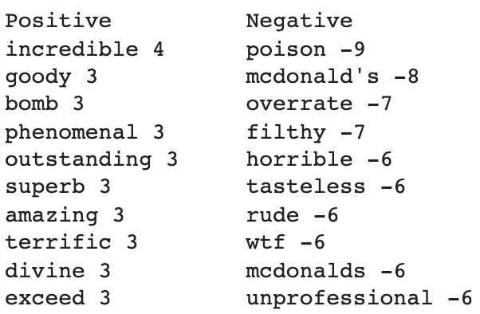
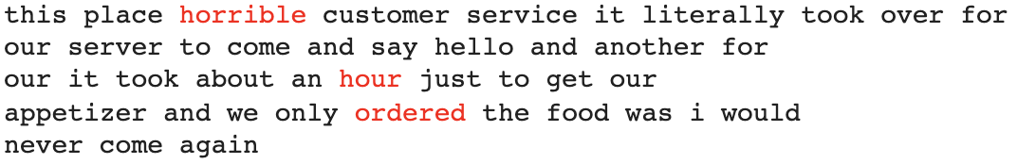
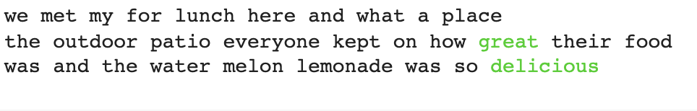
Understanding vocabulary
- When predicting star using word occurrences, positive word should “increase” star and negative word should “decrease” star by degree of its coefficient.
- Assign “word score” using MLR coefficient!
Figure 2: Comment text, red if score <= - 0.1
Figure 1: words and their scores
Figure 3: Comment text, green if score >= 0.1

Slide 8
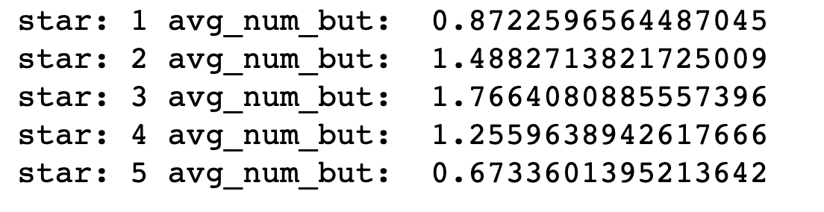
Feature Engineering
Above data engineering boils down to 1003 new features:
positiveScore: sum of positive word scores
negativeScore: sum of negative word scores
num_but: number of “but”, “yet”, “however” in the comment text
word1, word2, …, word1000: occurrences of words in vocabulary the in comment text
Figure 1: num_but differentiates “uncertain” comments from “certain” ones

Slide 9
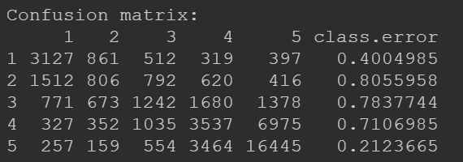
Model Fitting and Feature Selection - Random Forest
With the positiveScore, negativeScore, nWord, nChar, and num_but, we fit a random forest model with ntree = 200. The resulting error matrix is presented below:

Slide 10
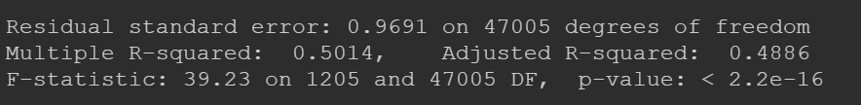
Model Fitting and Feature Selection - MLR
Input for MLR: adjective occurrences, positiveScore, negativeScore, nWord, nChar, and num_but, without postalCodesitive...

Slide 11
Model Fitting and Feature Selection - Ensemble Learning
Instead of using MLR model for ensemble learning, we experiment on a tree-based ensemble learning model, conditional inference tree (ctree in R).
We include predictions from MLR and random forest, plus positiveScore, negativeScore, nWord, nChar, and num_but as the input for the decision tree
Note: for this part, we have not figured out a perfect explanation for this ensemble learning strategy; but one reason behind this is that it can better reflect the difference in information provided by MLR and RF

Slide 12
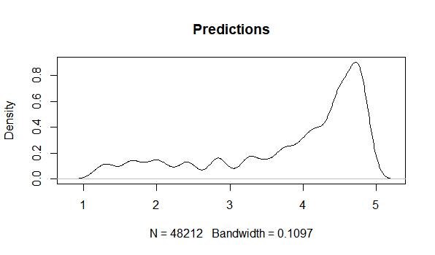
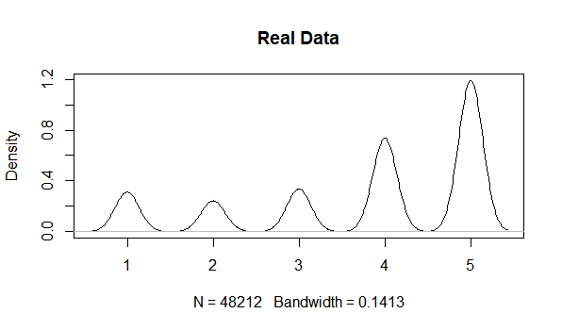
Model Diagnosis - Test/Prediction Comparison and RMSE

Slide 13
Pros and Cons of the Model
Pros:
The final accuracy is relatively good with Kaggle RMSE = 0.86
Include sentiment analysis with MLR and come up with new predictors that better reflect the reviews’ positivity or negativity.
Cons:
Lacking feature selection procedure due to the time limit.
Did not give detailed error estimation
Did not given detailed interpretation of ensemble learning with ctree

Slide 14
Possible Future Improvements
Conduct feature selection with VIF regression to increase the interpretability of the MLR model to further refine the positiveScore and negativeScore; also, this will save more computational sources during model fitting
We might consider multinomial logistics regression to improve the prediction accuracy.
Add error estimation with bootstrap to make the model prediction more comprehensive.
Use newly-come-up features as predictors instead of fitting all work occurrence

